Slide 1

Where is a mobile map used in map-assisted pedestrian navigation?
Author: Zhengfang Xu
Supervisor: Prof. Dr. Sara Irina Fabrikant
Dr. Mona Bartling

Slide 2
Intro
RQ
Data
Method
Timeline
When using a mobile map to navigate to a new place, where do you need to unlock the phone screen and check the map?

Slide 3

Intro
RQ
Data
Method
Timeline
To understand where people check the map, we need to know why people check the map.
Related research: motivations behind checking the map
Wayfinding behavioral actions are those linked to:
orientation,
route decision,
route monitoring,
destination recognition
(Carpman & Grant, 2002)

Slide 4

Intro
RQ
Data
Method
Timeline
Checking map assists people in making decision during navigation.
Related research: decision making during navigation
Pedestrians tend to make decisions before reaching intersections.
People with higher spatial ability, are earlier to make decisions.
(Brunyé et al., 2018)

Slide 5




Intro
RQ
Data
Method
Timeline
Map use strategies help us understand where people check maps.
Related research: types of map use strategies during navigation
constant
support
independent and attentive
least effort and inattentive
(Webber et al., 2012)

Slide 6
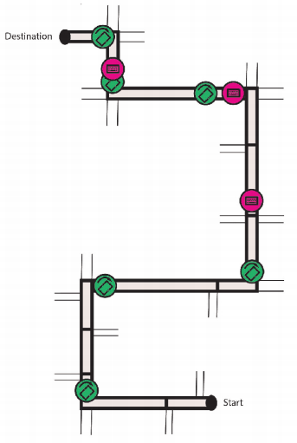
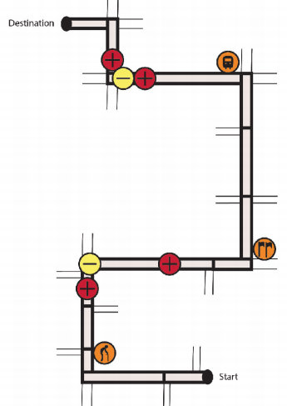
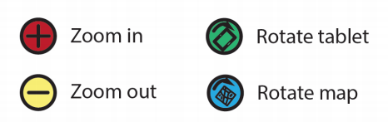
Intro
RQ
Data
Method
Timeline
Map use strategies help us understand where people check maps.
Related research: types of map use strategies during navigation
Taking specific map interaction types into consideration.
(Brügger, 2020)

Slide 7
Intro
RQ
Data
Method
Timeline
Research Gap:
The existing research on map checking primarily focuses on intersections, with fewer studies investigating other trajectory factors with map checking. (e.g., road length, turns, landmarks, shortcuts etc.).
Most studies use predetermined routes for their experiments and seldom consider the impact of route variations.
Example: In Brügger‘s experiment, a predefined route with 5 turns was used. What if the route has intersections but no turns?
Little research explored how environmental conditions, such as traffic density, affect people's map-checking behavior.

Slide 8
Intro
RQ
Data
Method
Timeline
Research Question:
1. What are trajectory factors (e.g., intersections, turns, length etc.) that influence pedestrian map checking behavior, and how do these factors affect the map checking behavior?
2. What are the differences in map-checking behavior between heavy and light traffic density conditions?

Slide 9
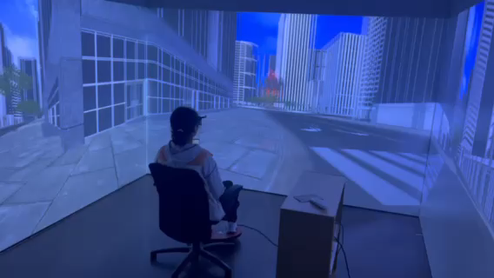
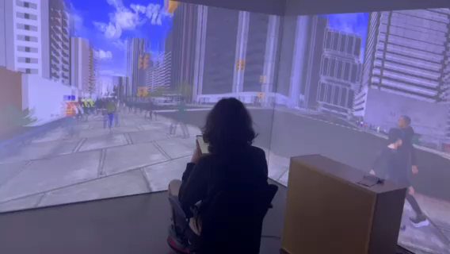
Intro
RQ
Data
Method
Timeline
Data source: VR Experiment
Study on mobile map assisted wayfinding
(Bartling et al., 2023)
Total study participants: 54
Environmental condition:
Light and heavy traffic density
Number of recorded wayfinding task trajectories: 863
The behavior of users unlocking the screen has been recorded

Slide 10
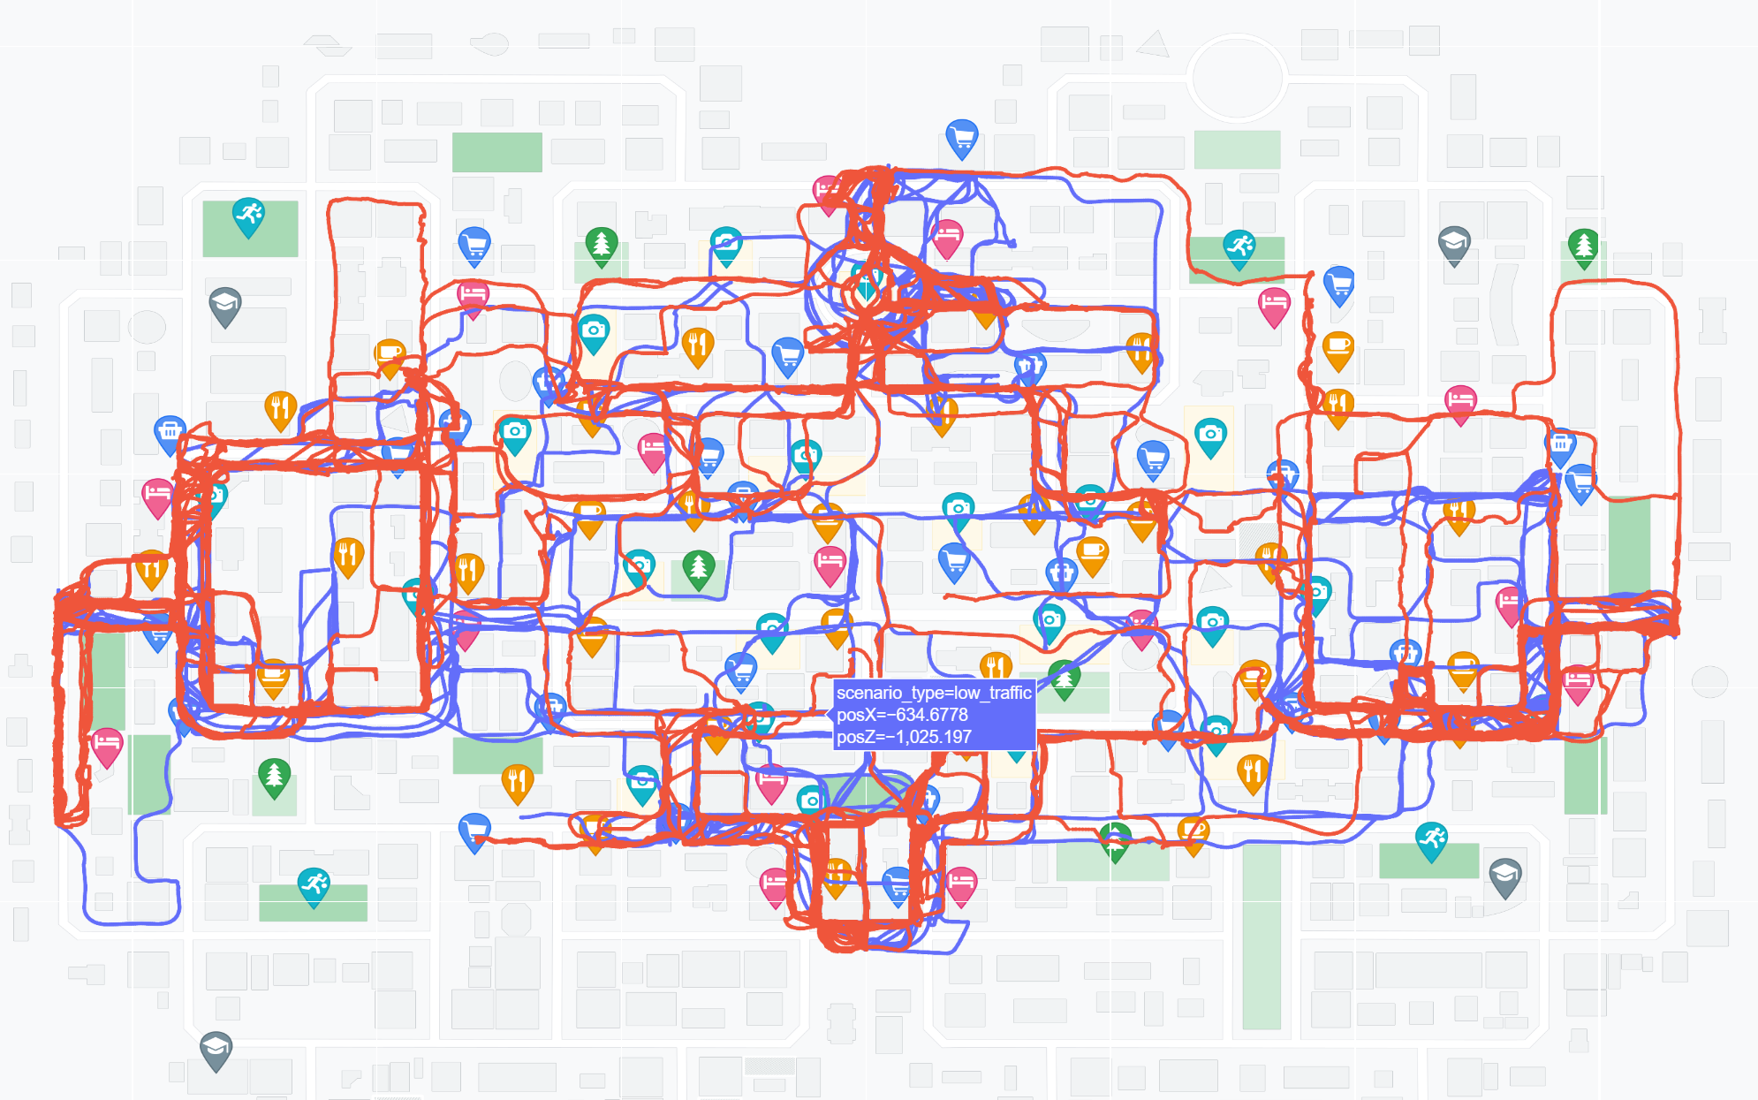
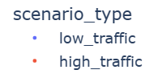
Intro
RQ
Data
Method
Timeline
Data source :
Light traffic
Heavy traffic

Slide 11
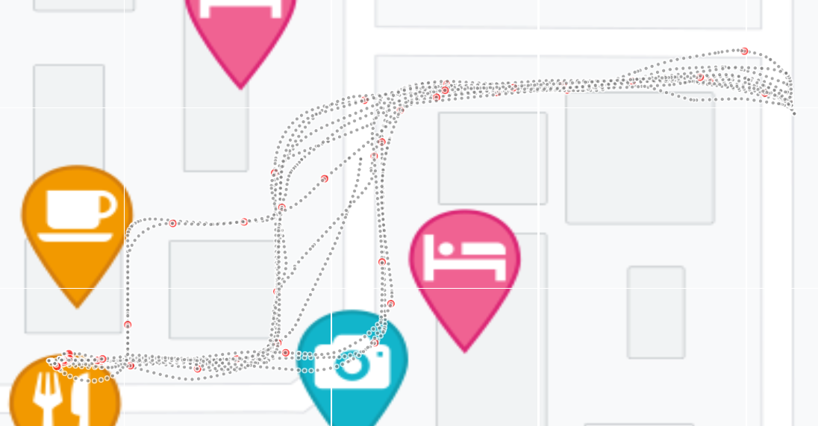
Intro
RQ
Data
Method
Timeline
Data source :

Slide 12
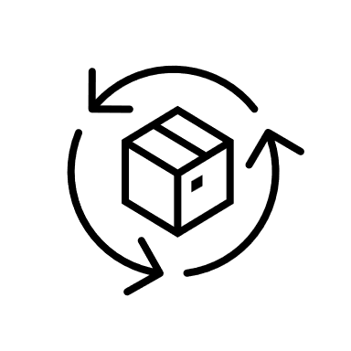
Intro
RQ
Data
Method
Timeline
Method:
To answer the RQ, I want to approach the research from two perspectives:
Number of map checking in a trajectory/ Locations of map checking in a trajectory

Slide 13
Intro
RQ
Data
Method
Timeline
Method:
Exploratory data analysis on potential factors which influence the number of map checking in a trajectory
Length, number of turns, number of intersections, shortcut involvement, numbers of landmarks, etc.
Regression analysis on individual factors with the number of map checking
Number
Establish comprehensive model to predict the number of map checking for a trajectory
Comparative analysis between traffic density
Comparing the differences between heavy traffic density and light traffic density.
(e.g., Do landmarks have a significant impact on the number of map checking during light traffic conditions, but not during heavy traffic?)

Slide 14
Intro
RQ
Data
Method
Timeline
Method:
Abstracting trajectory
Enabling complex pedestrian trajectories to be clustered and compared.
Location

Slide 15
Intro
RQ
Data
Method
Timeline
Method:
Cluster the abstracted trajectories based on the distribution of key factors.
e.g., start point - turn - turn – destination or start point - intersection - intersection - turn – destination, etc.
Visualize map checking points on the abstracted trajectories
Location
Comparative analysis
Compare the distribution of map checking points across trajectories from different clusters.
Compare the distribution of map checking points across trajectories within the same cluster but different traffic densities.

Slide 16
Intro
RQ
Data
Method
Timeline
1 Feb. 2024
Start of master thesis
16 Apr. 2024
Concept talk
15 May 2024
Exploratory analysis
15 June 2024
Number of map checking analysis
15 July 2024
Locations of map checking
analysis
31 Aug. 2024
Thesis writing
30 Sep. 2024
Submission of the Master’s Thesis
1 Nov. 2024
Master’s Exam

Slide 17

Thank you very much!

